Slide 1
Sprawozdanie z działalności Redaktorów Naczelnych i Rady Naukowej (Editorial Board) czasopisma Neurologia Neurochirurgia Polska (Polish Journal of Neurology & Neurosurgery)

Slide 2
Redaktorzy Naczelni: Jarosław Sławek, Zbigniew K. Wszołek
Redaktor prowadząca: Dorota Czarnocka (Via Medica)
Dyrektor Informacji Medycznej: Łukasz Stolarczyk (Via Medica)

Slide 3
Welcome - new (23) members of Editorial Advisory Board, candence 2021 - 2023
Victor Constantinescau, University of Medicine and Pharmacy, Iasi, Romania
Jarosław Dulski, Medical University of Gdansk
Jean Michelle Gracies, Paris-Est University, France
Sanjeet Grewal, Mayo Clinic Florida, USA
Robert Jech, General University Hospital in Prague, Chech Rep.
Michał Karliński, Inst. of Psychiatry and Neurology, Warsaw
Magdalena Koszewicz, Inst. of Psychiatry and Neurology, Warsaw
Aneta Lasek-Bal, Medical University of Silesia, Katowice
Tomasz Mandat, Medical Academy in Lodz
Marcin Mycko, University of Warmia and Mazury, Olsztyn
Nicola Pavese, Clinical Ageing Research Unit Newcastle University, United Kingdom
Anna Potulska-Chromik, Medical University of Warsaw
Jason Siegel, Mayo Clinic Florida, USA
Mariusz Siemiński, Medical University of Gdansk
Emilia Sitek, Medical University of Gdansk
Joanna Siuda, Medical University of Silesia, Katowice
Matej Skorvanek, Pavol J. Safaric University in Kosice, Slovakia
Agnieszka Słowik, Jagiellonian University, Krakow
Michał Sobstyl, Inst. of Psychiatry and Neurology, Warsaw
Stanisław Szlufik, Medical University of Warsaw
Tomasz Szmuda, Medical University of Gdansk
Pille Taba, University of Tartu, Estonia
Philip Tipton, Mayo Clinic Florida, USA
Zmiana składu EB w 2021

Slide 4
Introduction of new publication model for „Neurologia i Neurochirurgia Polska”
Zmiana sposobu wydawania pisma na Open Access
Publication models of STM journals (Science, Technology and Medicine) considering access to content:
1. HYBRID ACCESS
Authors themselves decide whether their paper accepted for publication will be accessible for readers free of charge (open access)
or by paid access (pay per article / pay per view / subscription)
ADVANTAGE: author and/or his institution is not obliged to cover APC (Author Publication Charge)
DISADVANTAGE: sizeable percentage of journals is not widely available
2 OPEN ACCESS
Authors and / or their institutions are obliged to pay APC for papers accepted for publication
ADVANTAGE: all content of a journal is available widely, freely and permanently
DISADVANTAGE: author and/or his institution is not obliged to cover APC
3 SUBSCRIPTION MODEL
Most traditional, systematically disappearing

Slide 5
Introduction of new publication model for „Neurologia i Neurochirurgia Polska”
Open Access – color coding
Gold OA
Green OA
Brown OA
Platinum OA
Black OA
Creative Commons Licences
Attribution CC BY
Attribution ShareAlike CC BY-SA
Attribution NoDerivs CC BY-ND
Attribution NonCommercial CC BY-NC
Attribution NonCommercial-ShareAlike CC BY-ND-SA
Attribution NonCommercial-NoDerivs CC BY-NC-ND

Slide 6
Introduction of new publication model for „Neurologia i Neurochirurgia Polska”
Journal Data Filtered By: Selected JCR Year: 2019 Selected Editions: SCIE Selected Categories: 'CLINICAL NEUROLOGY' Selected Category Scheme: WoS Selected Open Access
Rank | Full Journal Title | Total Cites | Journal IF | APC (USD)
1 | Neurology-Neuroimmunology & Neuroinflammation | 2,232 | 7.724 | 3450,00
2 | Alzheimers Research & Therapy | 3,876 | 6.116 | 2790,00
3 | Pain and Therapy | 354 | 5.526 | ?
4 | Therapeutic Advances in Neurological Disorders | 1,421 | 5.000 | 2300,00
5 | JOURNAL OF HEADACHE AND PAIN | 3,898 | 4.797 | 2490,00
6 | Stroke and Vascular Neurology | 496 | 4.765 | 2000,00
7 | Nature and Science of Sleep | 728 | 4.375 | 2750,00
8 | INTERNATIONAL JOURNAL OF NEUROPSYCHOPHARMACOLOGY | 6,749 | 4.333 | 2530,00 | 1500,00 (CINP members)
9 | Annals of Clinical and Translational Neurology | 2,571 | 3.660 | 3300,00 | 1650,00 (ANA membemrs)
10 | Neurology-Genetics | 804 | 3.509 | 3300,00
11 | Journal of Neurodevelopmental Disorders | 1,342 | 3.487 | 2190,00
12 | Frontiers in Neurology | 9,998 | 2.889 | 1850,00
13 | Global Spine Journal | 1,410 | 2.683 | 1500,00
14 | Journal of Pain Research | 3,235 | 2.386 | 2750,00
15 | BMC Neurology | 5,731 | 2.356 | 1990,00
16 | NEUROLOGIA | 1,280 | 2.283 | 0,00 | covered by "Sociedad Española de Neurología"
17 | Neuropsychiatric Disease and Treatment | 6,067 | 2.157 | 2750,00
18 | Pain Research & Management | 1,741 | 2.153 | 2100,00
19 | BEHAVIOURAL NEUROLOGY | 1,561 | 2.093 | 1650,00
20 | Parkinsons Disease | 1,344 | 1.758 | 1800,00
21 | Korean Journal of Pain | 502 | 1.431 | 0,00 | all costs covered by Korean Pain Society
22 | Journal of Korean Neurosurgical Society | 2,119 | 1.376 | 300,00
APC for PJNNS – 07-08/2021
250,00 USD - PTN / EB
450,00 USD – other authors

Slide 7
Journal status quo – data from manuscripts system 2019 – 2020 (submissions)
Obecny stan czasopisma- dane co do submisji artykułów

Slide 8
Journal status quo – data from manuscripts system 2019 – 2020 (submissions)

Slide 9
Journal status quo – data from manuscripts system 2019 – 2020 (timing)

Slide 10
Journal status quo – data from manuscripts system 2019 – 2020 (timing)
issue | date_published
1/2020 | 2020-02-29 00:00:00
2/2020 | 2020-04-30 11:51:40
3/2020 | 2020-06-30 15:27:09
4/2020 | 2020-08-31 00:00:00
5/2020 | 2020-10-30 17:23:34
6/2020 | 2020-12-31 00:00:00
issue | date_published
1/2019 | 2019-02-28 00:00:00
2/2019 | 2019-04-30 00:00:00
3/2019 | 2019-06-27 00:00:00
4/2019 | 2019-08-30 21:17:15
5/2019 | 2019-10-30 13:36:38
6/2019 | 2019-12-31 14:29:29
Congratulations to All involved – no delay for even a day over 2 years!

Slide 11
Journal status quo – data from manuscripts system 2019 – 2020 (reviews)

Slide 12
Journal status quo – data from manuscripts system 2019 – 2020 (reviews)

Slide 13
Journal status quo – data from manuscripts system 2019 – 2020
Top 10 downloads – papers 2019
issue | title | author | downloaded
2/2019 | Vitamin D as an immune modulator in multiple sclerosis | Bartosik-Psujek | 4068
6/2019 | Assessment of the effects of dysphagia therapy in patients in the early post-stroke period: a randomised controlled trial | Krajczy | 2543
6/2019 | Eye signs for the neurologist in the Intensive Care Unit | Sreenivas | 2526
5/2019 | Novel emerging treatments for NMOSD | Selmaj | 1559
1/2019 | A systematic review of Gamma-aminobutyric Acid Receptor Type B autoimmunity | McKay | 1329
4/2019 | Acute bacterial meningitis and stroke | Siegel | 1212
1/2019 | No association between MRI changes in the lumbar spine and intensity of pain, quality of life, depressive and anxiety symptoms in patients with low back pain | Babińska | 1143
2/2019 | Health-related quality of life and medication adherence in elderly patients with epilepsy | Hamedi-Shahraki | 1069
2/2019 | Positron emission tomography neuroimaging in neurodegenerative diseases: Alzheimer’s disease, Parkinson’s disease, and amyotrophic lateral sclerosis | Barc | 993
1/2019 | Neurosurgical cadaveric and in vivo large animal training models for cranial and spinal approaches and techniques — a systematic review of the current literature | Morosanu | 960

Slide 14
Journal status quo – data from manuscripts system 2019 – 2020
Top 10 downloads – papers 2020
issue | title | author | downloaded
3/2020 | Does amantadine have a protective effect against COVID-19? | Cortés Borra | 18348
3/2020 | Response to “Does amantadine have a protective effect against COVID-19?” | Tipton | 3875
2/2020 | What can Parkinson’s disease teach us about COVID-19? | Tipton | 3139
1/2020 | Real-world effectiveness of abobotulinumtoxinA (Dysport®) in adults with upper limb spasticity in routine clinical practice: an observational study | Sarzyńska-Długosz | 1166
2/2020 | Vestibular migraine — an underdiagnosed cause of vertigo. Diagnosis and treatment | Nowaczewska | 1161
2/2020 | Clinical and epidemiological characteristics of multiple sclerosis patients receiving disease-modifying treatment in Poland | Kapica-Topczewska | 1156
3/2020 | Cervical dystonia — improving the effectiveness of botulinum toxin therapy | Tyślerowicz | 1148
6/2020 | B cell targeting therapies in MS patients during the SARS-CoV-2 pandemic — when immunosuppression meets infection? | Mycko | 1113
2/2020 | Telemedicine in neurosurgery during the novel coronavirus (COVID-19) pandemic | Szmuda | 1086
2/2020 | Recommendations for neurological, obstetrical and gynaecological care in women with multiple sclerosis: a statement by a working group convened by the Section of Multiple Sclerosis and Neuroimmunology of the Polish Neurological Society | Kalinowska | 901

Slide 15
Journal status quo – data Web of Science Core Collection 2018 – 2020 (as of APR 15, 2021)

Slide 16
Journal status quo – data Web of Science Core Collection 2018 – 2020 (as of APR 15, 2021)

Slide 17
Journal status quo – data Web of Science Core Collection 2018 – 2020 (as of APR 15, 2021)

Slide 18
Journal status quo – data Web of Science Core Collection 2018 – 2020 (as of APR 15, 2021)

Slide 19
Journal status quo – data Web of Science Core Collection 2018 – 2020 (as of APR 15, 2021)
2019
2020 - prognosis
JIF 2020 = 274 / 111 + 64 = 1.575
Ostateczny IF za 2020 rok: 1, 62!!!

Slide 20
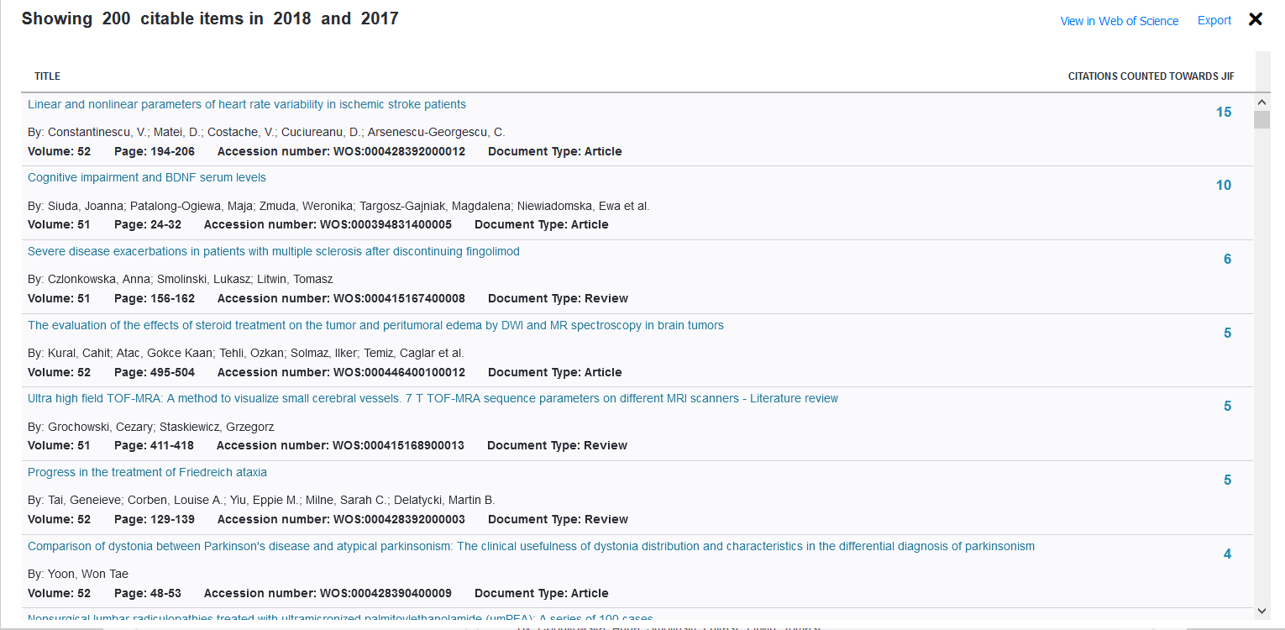
Journal status quo – data Web of Science Core Collection 2018 – 2020 (as of APR 15, 2021)
Magnificient Seven 2019

Slide 21
Journal status quo – data Web of Science Core Collection 2018 – 2020 (as of APR 15, 2021)
Magnificient Seven 2020
2020

Slide 22
Journal status quo – data Web of Science Core Collection 2018 – 2020 (as of APR 15, 2021)
Compare Journals

Slide 23
Journal status quo – data Web of Science Core Collection 2018 – 2020 (as of APR 15, 2021)
Compare Journals

Slide 24
Journal status quo – data Web of Science Core Collection 2018 – 2020 (as of APR 15, 2021)
Compare Journals

Slide 25
Journal status quo – data Web of Science Core Collection 2018 – 2020 (as of APR 15, 2021)
Compare Journals

Slide 26
Journal status quo – data Web of Science Core Collection 2018 – 2020 (as of APR 15, 2021)
Compare Journals

Slide 27
Keypoints on co-operation of Editorial Advisory Board (EAB) with Editors-in-Chief (minutes of meeting; June 23, 2020)
Further increase of reviewing activity of EAB members
Contribution to citations and autocitation taking advantage also of journals indexed in ESCI (Emerging Sources Citation Index)
EAB involvement in <Leading Topics>
EAB contribution in Invited Editorials, Letters and Commentaries
Further improvement in STP publishing and bibliometric skills
Still valid …

Slide 28
Podsumowanie:
Własnością PTN jest Neurologia Neurochirurgia Polska, prowadzona przez prof. Andrzeja Szczudlika do 2018 roku. Od tego czasu współredaktorami naczelnymi są prof. Zbigniew K. Wszołek z Mayo Clinic, Jacksonville, USA oraz Jarosław Sławek, Gdański Uniwersytet Medyczny.
Na stałe jako redaktor techniczny do połowy 2019 roku pracował dr hab. Mariusz Siemiński, sekretarzem technicznym była i jest Pani Dorota Czarnocka. Obecnie zrezygnowaliśmy z funkcji redaktora technicznego i zespół redakcji stanowi Pani sekretarz techniczna oraz 2 Redaktorów Naczelnych, co w naszym mniemaniu usprawniło pracę i przepływ informacji. Czasopismo było początkowo wydawane przez Elsevier, obecnie od 2019 roku przez Via Medica. Ukazuje się regularnie, bez opóźnień, 6 zeszytów w ciągu roku. Redaktorzy odbyli 3 spotkania z członkami Editorial Board, ostatnie z zagranicznymi członkami w czerwcu 2021. W czasie kadencji EB uległ odnowieniu w zakresie zarówno polskich jak i zagranicznych jego członków. Najważniejszym osiągnięciem jest wzrost współczynnika oddziaływania IF do 1,62 w roku 2021.
Ogromne podziękowania za zaangażowanie i energię dla prof. Zbigniewa Wszołka!!!!

